Slide 1

STAR
Overview
7-25-2023
Notes:
Good morning my name is Ally Lambert, I am the Crisis Information Systems Programmer for the region working out of the City of Houston OEM. Today we are going to be reviewing the State of Texas assistance request board and process “The STAR Board” specifically within WebEOC.

Slide 2
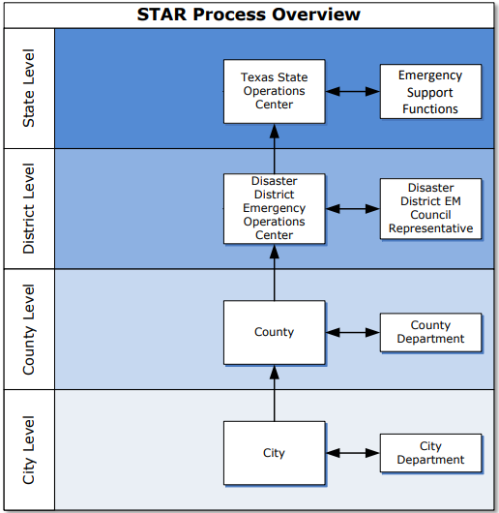

State of Texas assistance request
Streamlines resource requests statewide
Star Web form allows submissions direct to DDC or SOC levels.
Notes:
The STAR is the standardized process for requesting resources and assets from the State, a County or a City, resources such as water, heavy machinery, and personnel.

Slide 3

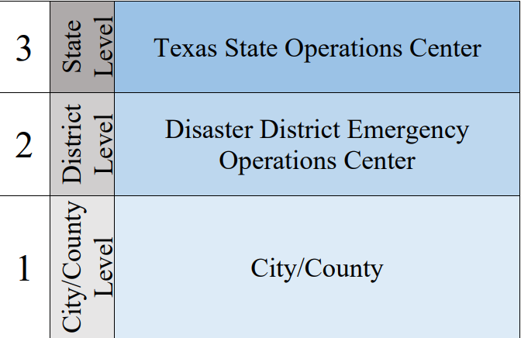
Resource Requests & Management in Texas
Local jurisdiction, regional entities, state agencies and organizations may request resources to support disaster response operations. The Texas SOC Fulfills requests for assistance with available resources from the Emergency Management Council Members, available contractors or venders, interstate or federal resources, as available, to fill the request.
The chart above provides an overview of emergency management coordination in Texas.

Slide 4
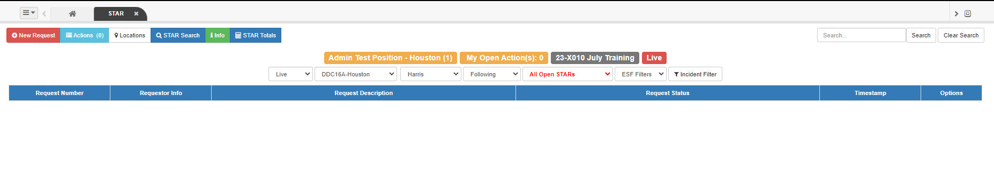
Getting to know the star board
Notes:
When users open the STAR Board, the Live Requests view opens. This view displays all live requests within your jurisdiction. Users may select a filter or a combination of filters at the top of the page to increase or decrease the number of visible requests.

Slide 5
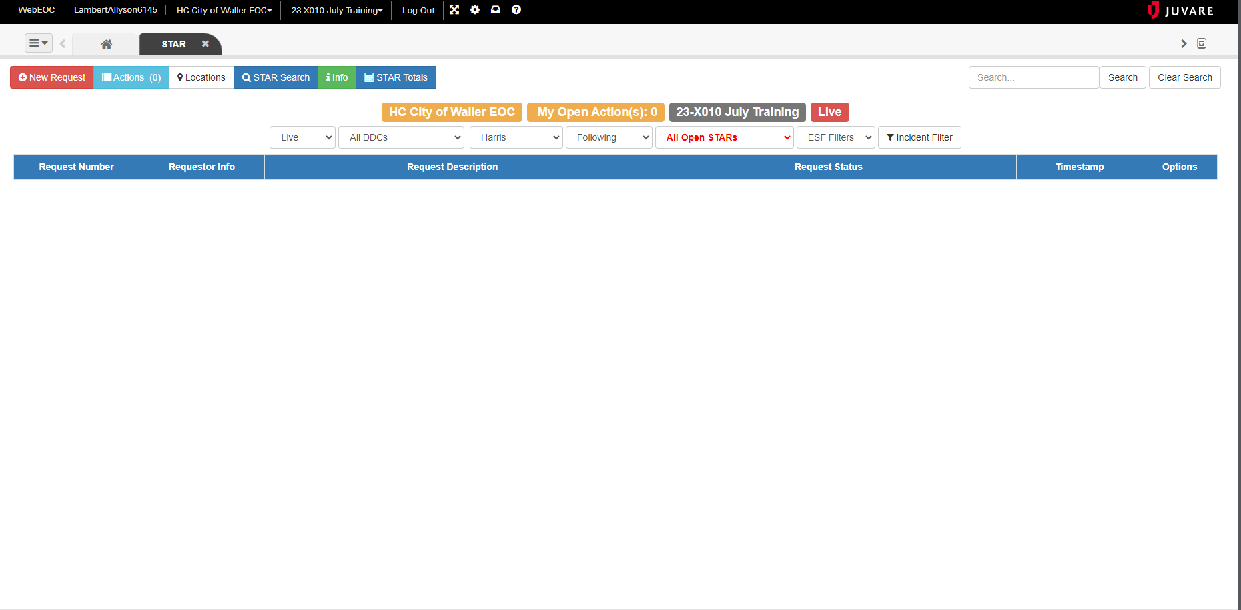
STAR Board main display
Can toggle between Live environment and the training environment.
Search by Star Number, Requestor, Description
Incident, Position, Live/Training
Incident Filter
Notes:
In the Live View you have the capabilities of viewing all live requests from your position and open actions. You can also filter through these requests using the incident filter to better aid with viewing the request along with using the Search Bar or button. In the search bar you can search by the Star Number, this is a record number assigned by the system which automatically populates under the request number column. You can search by the requestor so the person who entered the STAR and then a description, terms like water, generator will pull up those key words in the STARs.

Slide 6
STAR Board main display
Filter Bar
New Request ( Live environment is red, training environment the new request button will be blue).
STAR Statuses
Counties
DDC (Disaster District Committee)
DDC provides guidance and admin support during a disaster response
Notes:
On the Main Display we have the new request button, in the Live view this will be colored red. In the training view it will be colored blue. We have the filter bar which displays the current environment you are in, the DDC STAR Jurisdiction which you are viewing , the county, along with Star Status filters.

Slide 7
STAR Board main display
Action View Actions allow users to provide additional details about the fulfillment of requests. Additionally, Actions can be routed to partner organizations to request their support to fill a resource request. To displace the Actions view on the STAR Board, click the Actions button, located on the top left of the screen.
When using the search feature in the STAR
board, uses may search for items such as
request number, type, description or
requestor. If searching on STAR number,
only enter the last five or six digits (not the
xx-).
Notes:
There is an action button which allows you to view details of fulfillments on the requests made. These actions can be routed to partner stakeholders who can fill the request or support actions within a request. We have another way of searching for Stars which functions like the search bar, it will search through request numbers, types, descriptions and various variables in the system.

Slide 8
STAR BOARD
Action Status
Definitions
Submitted | The status assigned after the action is created and assigned for routing to the supporting party.
Submitted for Approval | The action has been marked for approval by the SOC management group.
Working | The status assigned when the responsible party is in the process of fulfilling the action.
Filled | The status assigned when the actions’ item description has been fulfilled.
Canceled | The status assigned when the action has been canceled by an individual in the SOC.
WEBEOC BASIC USER TRAINING
Notes:
Once a star is submitted, the appropriate responsible party can assign status to the star as they work through the fulfillment process.

Slide 9

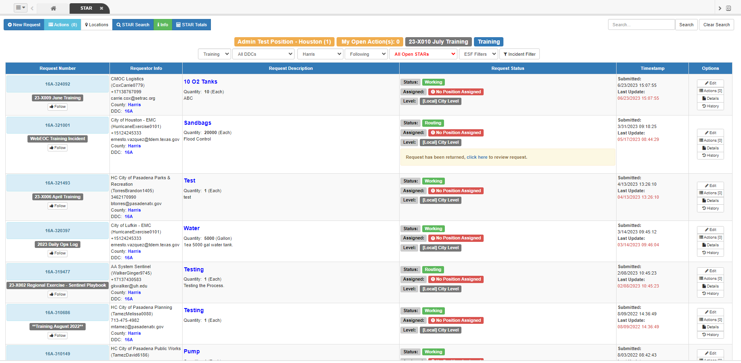
Training Environment
Training Environment will be indicated as the blue “New Request” button and in the Filter Bar.
Notes:
The training environment can be utilized

Slide 10
live Environment
Live Environment will be indicated as the red “New Request” button and in the Filter Bar.

Slide 11
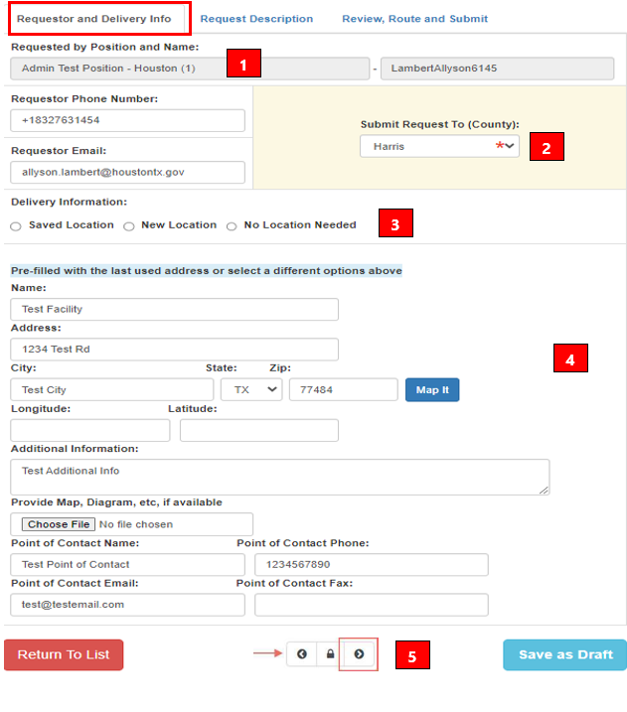
Create a star
Ensure requestor information is correct and modify as necessary.
Ensure appropriate selection is entered for submitting to City, County or higher.
Select a location option.
“Saved Location” or “New Location” if delivery of resources is requested.
Ensure address, city, state, and zip code are filled out.
Point of Contact: Ensure all applicable information is filled out.
Once completed, select the right arrow at the bottom of the page to advance to the next section.

Slide 12
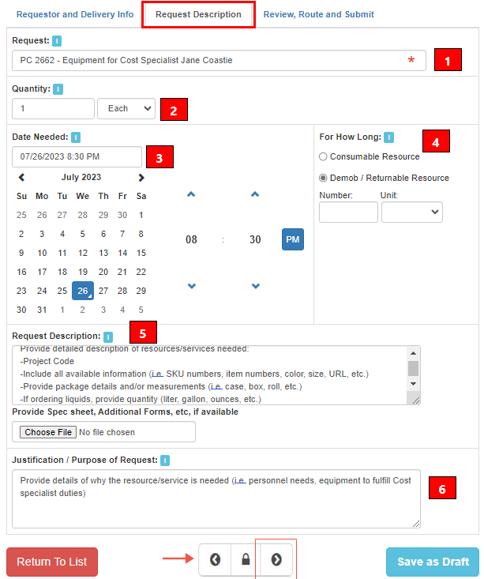
Request Description
Request: Title, Brief Description of request, and who or what the request is for. No additional information is required.
Quantity: Provide # of resources needed.
Date : Select the date and time resource or service is needed. This is NOT the date the STAR was created.
For How Long: Provide length of time resource is required, can be:
  Consumable: Resource will be consumed / not returned (i.e., personnel, bottled water, paper goods).
  Demob / Returnable Resource: Resource will be demobilized when no longer needed and returned to appropriate location/vendor.
- If you do not know the length of time the resource is needed, leave the date filed blank.
Request Description: Provide details of resource/service requested (see below).
Justification: Why is the resource/service needed.
Once completed, select the right arrow at the bottom of the page to advance to the next section.

Slide 13
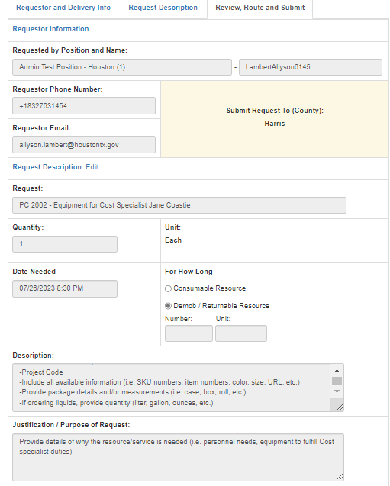
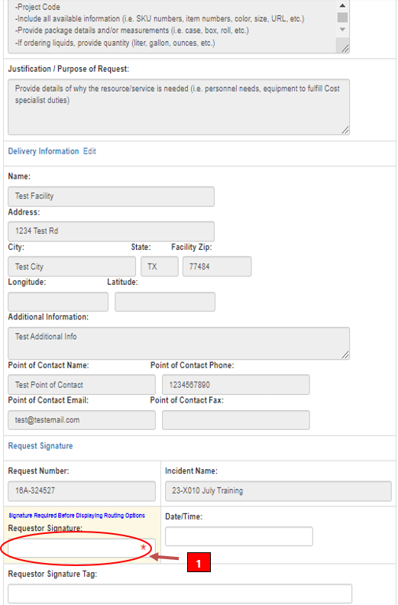

Review
Review all fields for accuracy.
Review all fields for accuracy.
Type your name in the “Requestor Signature Box”, this will populate new fields below for routing.

Slide 14
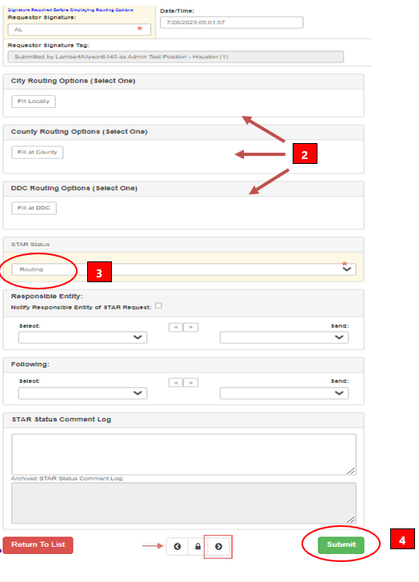
Route and Submit
Enter your first and last name in “Requestor Signature” block. Date and time with auto-populate.
Departments may only route to “Fill Locally.”
Cities may “Fill Locally” or, if the resource is not available at the City level, “Route to County.”
Counties may “Fill at County” or “Route to DDC.”
STAR Status
Upon Selection of routing option, STAR will automatically move to “Working” Status.
Change the status to routing.
Responsible Entity
  From the drop-down box on the left, select the appropriate position to work the STAR.
  Once selected, utilize the right-side arrow to move the selected position over to the “Send” field at the right.
Submit: Once all fields have been reviewed for accuracy, click “Submit” (bottom right) to finish the STAR Submission.

Slide 15
Routing | The resource request is progressing through and on its way to the responsible party.
Working | A STAR is denoted as working after it arrives at the responsible party.
Filled | Activities fulfilling the resource request are completed at the SOC level and every associated action has been marked as filled.
Not Filled | The resource request is unable to be filled due to an external or internal factor.
Canceled | The requested resource is no longer needed or has been acquired from a different source; no further action is required.
STAR BOARD
Routing Level Definitions
WEBEOC BASIC USER TRAINING

